Slide 1
Overview of Recommended Practice - SAE J3061TM Cybersecurity Guidebook for
cyber-physical vehicle systems
January 2016
Lisa Boran
Ford Motor Company
SAE J3061 Committee Chair

Slide 2
AGENDA
Motivation
Main Content of J3061TM
Current Status
Notes:
Notes: Possibly move up the goal slide

Slide 3
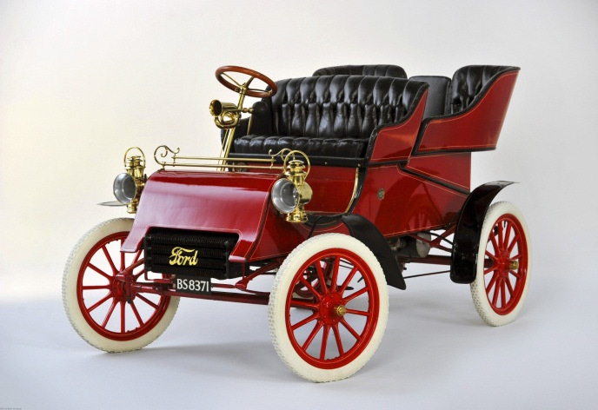
Motivation for Creating SAE J3061TM
Past Vehicle Design Emphasis was on Engine Design, Comfort and Chassis
Vehicle was self contained

Slide 4
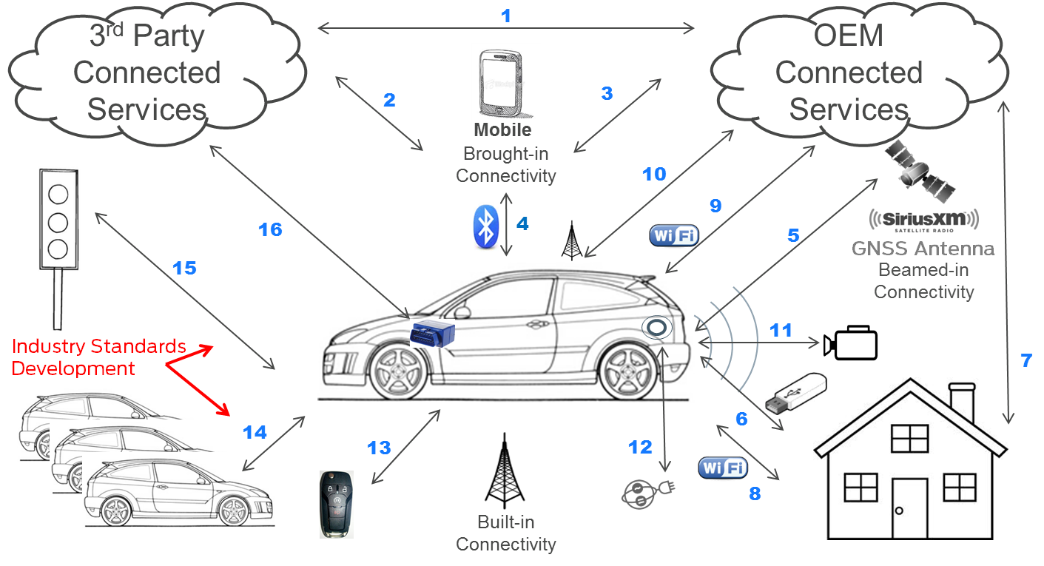
Motivation for Creating SAE J3061TM
Interconnectivity of today’s and future vehicles makes them potential targets for attack

Slide 5
Why standards are needed: Security Considerations
The connected world poses threats to:
Product Safety and Performance
Data Integrity and Access
Privacy
Interoperability
J3061™ Establishes needed guidance and recommendations for designing cybersecurity into the system including product design, validation, deployment and communication tasks
Infographic by Ashleigh N. Faith 2015

Slide 6
Motivation for Creating SAE J3061TM
Cybersecurity is relatively new to automotive, and most existing information does not address unique aspects of embedded controllers
Cybersecurity principles, process and terminology are needed that can be commonly understood between OEMs, Tier 1 suppliers & key stakeholders
A defined and structured process helps ensure that cybersecurity is built in to the design throughout product development
Based on ISO 26262 Functional Safety process framework
No system can be guaranteed 100% secure
Following a structured process helps reduce the likelihood of a successful attack, thus reducing the likelihood of losses
A structured process also provides a clear means to react to a continually changing threat landscape

Slide 7
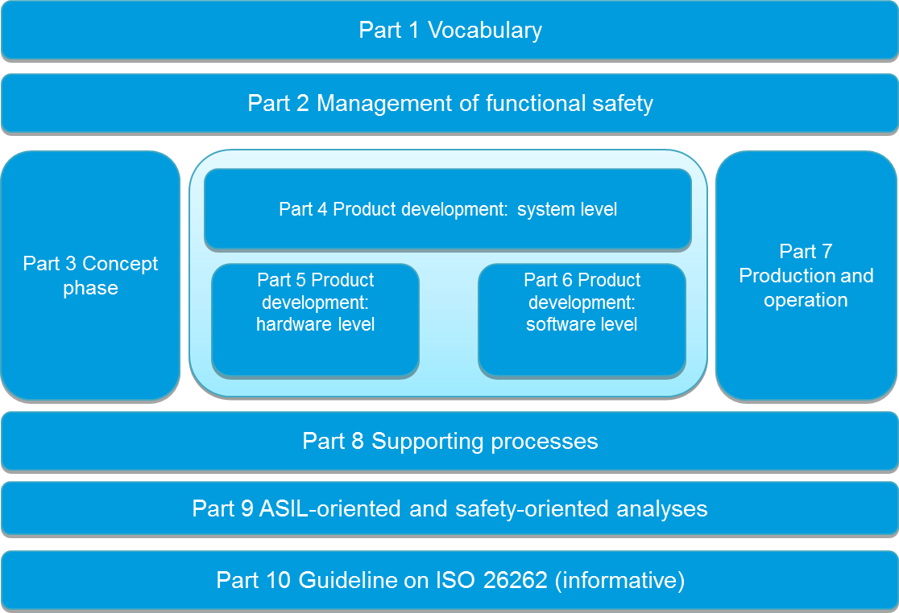
ISO 26262 Process Framework vs. Cybersecurity Process Framework
ISO 26262
Source: draft document J3061TM
Copyright SAE International
SAE J3061TM

Slide 8
1. Scope
Describes the application and purpose of J3061TM and provides application guidance.
Provides guidance on vehicle cybersecurity
Intended to be flexible, pragmatic, and adaptable in its application to the vehicle industry as well as to other cyber-physical vehicle systems
e.g., commercial and military vehicles, trucks, busses
Defines a complete lifecycle process framework
Provides information on existing tools and methods used when designing, verifying, and validating cyber-physical vehicle systems
Provides high-level guiding principles on cybersecurity for CPVS
Provides the foundation for further standards development activities in vehicle cybersecurity
Provides guidance on when to apply a cybersecurity process

Slide 9
3. Definitions
Throughout the document, the initial use of a word contained in the definition section is bold italics.
Key Definitions
Cyber-physical system – a system of collaborating computational elements controlling physical entities
Cybersecurity – an attribute of a cyber-physical system that relates to avoiding unreasonable risk due to an attack
Attack – exploitation of vulnerabilities to obtain unauthorized access to or control of assets with the intent to cause harm
Threat – a circumstance or event with potential to cause harm
NOTE: Harm may be related to financial, operational performance, safety, reputation, privacy and/or sensitive data

Slide 10
Key Definitions Vulnerability vs. Threat vs. Risk
Vulnerability
Risk = likelihood
of attack|success
Threat
Source: AutoImmune

Slide 11
4. Relationship Between System Safety and System Cybersecurity
Provides an overview of system safety and system cybersecurity and how the two domains are related and different.
Scope of cybersecurity is broader
All safety-critical systems are cybersecurity-critical systems, but not all cybersecurity systems are safety-critical
Describes the relationship between system safety engineering process elements and system cybersecurity engineering process elements
Describes analogies between system safety and system cybersecurity engineering (TARA vs. HARA, Attack Tree vs. Fault Tree)
Describes unique aspects of system safety and system cybersecurity
(Accident or Faults vs. Purposeful Malicious Attack)

Slide 12
5. Guiding Principles on Cybersecurity for Cyber-Physical Vehicle Systems
Provides some general guiding principles with respect to cybersecurity that are applicable to any organization within a company.
Know your Feature’s Cybersecurity Potential
Understand key cybersecurity principles
Consider the vehicle owners’ use of the feature
Implement cybersecurity in concept and design phases
Implement cybersecurity in development and validation
Implement cybersecurity in incident response
Cybersecurity considerations when the vehicle owner changes

Slide 13
6. CYBERSECURITY PROCESS OVERVIEW
As with system safety, cybersecurity must be built in to the feature rather than added on at the end of development. Building cybersecurity in to the design requires an appropriate lifecycle process from concept phase through production, operation, service and decommissioning.
Motivation for a well-defined and well-structured process
Process Framework
Overall management of cybersecurity
Concept Phase
Product Development
Product Development: System Level
Product Development: Hardware Level
Product Development: Software Level
Production, Operation and Service
Supporting Processes
Milestone and Gate Reviews
Notes:
Move this slide after motivation. Rename this slide Objectives and move up after motivation. Leave 4th bullet for now. Motivation/Objectives/Approach---Definitions should come after approach. Remove automotive and change to vehicle instead.

Slide 14
Concept Phase Flow Diagram
Feature Definition
Initiation of Cybersecurity Lifecycle (Planning)
Identify Highest Risk Potential Threats
Threat Analysis and Risk Assessment
Identify Cybersecurity Goals
Cybersecurity Concept
Identify Functional Cybersecurity Requirements
Source: draft document J3061TM
Copyright SAE International
Initial Cybersecurity Assessment
Concept Phase Review

Slide 15
7. OVERALL MANAGEMENT OF CYBERSECURITY
Creating, fostering, and sustaining a cybersecurity culture that supports and encourages effective achievement of cybersecurity within the organization.
Cybersecurity Culture
Measuring Conformance to a Cybersecurity Process
Identifying and Establishing Communication Channels
Developing and Implementing Training and Mentoring
Operation and Maintenance Activities
Incident Response Process
Field Monitoring Process
Notes:
Move this slide after motivation. Rename this slide Objectives and move up after motivation. Leave 4th bullet for now. Motivation/Objectives/Approach---Definitions should come after approach. Remove automotive and change to vehicle instead.

Slide 16
8. PROCESS IMPLEMENTATION
This section describes in detail the activities in each of the cybersecurity lifecycle phases discussed in the cybersecurity process overview section (Section 6). For each lifecycle phase, the activities are described and a description of a possible implementation of the activities is provided.
Applying a Cybersecurity Process Separately with Integrated Communication Points to a Safety Process
Applying a Cybersecurity Process in Conjunction with a Safety Process
Concept Phase
Product Development at the System Level
Product Development at the Hardware Level
Product Development at the Software Level
Production, Operation and Service
Supporting Processes
Notes:
Move this slide after motivation. Rename this slide Objectives and move up after motivation. Leave 4th bullet for now. Motivation/Objectives/Approach---Definitions should come after approach. Remove automotive and change to vehicle instead.

Slide 17
Potential Communications Paths During the Concept Phase Activities
Source: draft document J3061TM
Copyright SAE International

Slide 18
Cybersecurity V Model Relationship Between System, Hardware and Software Development Activities
Source: draft document J3061TM
Copyright SAE International

Slide 19
APPENDIX A: DESCRIPTION OF CYBERSECURITY ANALYSIS TECHNIQUES
This sections provides a description of different analysis methods. This helps guide the reader to determine which method may better suit their needs and also provides a start on how to apply a particular one.
Overview of Threat Analysis, Risk Assessment, & Vulnerability Analysis Methods
EVITA Method (E-safety Vehicle InTrusion protected Applications)
EVITA Applied at the Feature Level using THROP (Threat and Operability Analysis)
TVRA (Threats, Vulnerabilities and Risks (TVR) of a system to be Analyzed)
OCTAVE (Operationally Critical Threat, Asset, and Vulnerability Evaluation)
HEAVENS (HEAling Vulnerabilities to ENhance Software Security and Safety)
Attack Trees
Software Vulnerability Analysis
Overview of Cybersecurity Testing Methods
Types of Penetration Testing
Red Teaming
Fuzz Testing
Notes:
Move this slide after motivation. Rename this slide Objectives and move up after motivation. Leave 4th bullet for now. Motivation/Objectives/Approach---Definitions should come after approach. Remove automotive and change to vehicle instead.

Slide 20
APPENDIX B: EXAMPLE TEMPLATES FOR WORK PRODUCTS
OCTAVE Worksheets
OCTAVE Allegro, Information Asset Risk Worksheet
OCTAVE Allegro, Risk Mitigation Worksheet
APPENDIX C: EXAMPLES USING IDENTIFIED ANALYSES
EVITA Application using THROP
OCTAVE
Attack Tree
HEAVENS
Notes:
Move this slide after motivation. Rename this slide Objectives and move up after motivation. Leave 4th bullet for now. Motivation/Objectives/Approach---Definitions should co
me after approach. Remove automotive and change to vehicle instead.

Slide 21
APPENDIX D: SECURITY & PRIVACY CONTROLS
DESCRIPTION AND APPLICATION
This appendix lists a sample set of 14 security control families and 5 privacy control families and a few controls within each family that might be applicable for automotive system security. The scope of coverage includes design, manufacturing, customer operation, maintenance, and disposal.
APPENDIX E: VULNERABILITY DATABASES AND
VULNERABILITY CLASSIFICATION SCHEMES
This appendix provides examples of dictionary and terminology sources for vulnerability databases (e.g. Common Weakness Enumeration, CWE) , vulnerability databases (e.g. BugTraq), and vulnerability classification schemes (e.g. Common Weakness Scoring System, CWSS).
Notes:
Move this slide after motivation. Rename this slide Objectives and move up after motivation. Leave 4th bullet for now. Motivation/Objectives/Approach---Definitions should come after approach. Remove automotive and change to vehicle instead.

Slide 22
APPENDIX F: VEHICLE LEVEL CONSIDERATIONS
Appendix F discusses aspects of vehicle-level Cybersecurity.
Architecture design considerations and partitioning using the NIST approach
Identify→ Protect→ Detect→ Respond→ Recover
After vehicle sale considerations (defaults, erasing, etc.)
End of life considerations
Communication reporting expectations from the supplier
APPENDIX G: CURRENT CYBERSECURITY STANDARDS &
GUIDELINES THAT MAY BE USEFUL TO AUTOMOTIVE INDUSTRY
Appendix G lists Standards and Guidelines from a variety of sources (e.g. NIST, FIPS, DHS, DARPA) that may be useful for members of the Vehicle Industry in understanding the overall Cybersecurity realm, and in determining the details of implementing Cybersecurity into their organizations.
Notes:
Move this slide after motivation. Rename this slide Objectives and move up after motivation. Leave 4th bullet for now. Motivation/Objectives/Approach---Definitions should come after approach. Remove automotive and change to vehicle instead.

Slide 23
APPENDIX H: VEHICLE PROJECT AWARENESS
Appendix H summarizes the key research projects on Vehicle Cybersecurity beginning with 2004 and up through the present . Examples are EVITA, SESAMO, HEAVENS.
APPENDIX I: SECURITY TEST TOOLS OF POTENTIAL USE TO THE
VEHICLE INDUSTRY
Appendix I lists some security test tool categories, and descriptions, for testing tools that may be of potential use to the vehicle industry for Cybersecurity.
○ Static Code Analyzer ○ Encryption Cracker
○ Dynamic Code Analyzer ○ Hardware Debugger
○ Network Traffic Analyzer ○ Known Answer Tester
○ Vulnerability Scanner ○ Application Tester
○ Fuzz Tester ○ Interface Scanner
○ Exploit Tester ○ Network Stress Tester
Notes:
Move this slide after motivation. Rename this slide Objectives and move up after motivation. Leave 4th bullet for now. Motivation/Objectives/Approach---Definitions should come after approach. Remove automotive and change to vehicle instead.

Slide 24
Current Status of J3061TM Surface Vehicle Recommended Practice
Three formal internal committee ballots performed
(86% approval or higher received)
Completed the 28-day Motor Vehicle Counsel Ballot
(80% participation with 70% approve and 10% waive)
Released January 15, 2016
“SAE J3061™: Cybersecurity Guidebook for Cyber-Physical Vehicle Standards” is available for sale at http://standards.sae.org/j3061_201601/ and an on-demand webinar reviewing SAE J3061™ is also available
https://event.webcasts.com/starthere.jsp?ei=1080592

Slide 25
Special Thanks!
Additional Authors of J3061TM
Brian Anderson, SwRI
Angela Barber, GM
Barb Czerny, zf TRW
Kevin Harnett, DOT
Mafijul Islam, Volvo
Justin Mendenhall, Ford
Steve Siko, FCA
Priyamvadha Vembar, Bosch
David Ward, MIRA
Tim Weisenberger, DOT
In addition there were a number of other people that contributed to the development of the document and we would like to thank those people as well!

Slide 26
Thank You!
If interested in participating in any of the 3 SAE Cybersecurity Committees:
TEVEES18 – Vehicle Electrical System Security
TEVEES18A – Automotive Security Guidelines and Risk Management
(J3061 Recommended Practice)
TEVEES18B – Electrical Hardware Security
(J3101 Recommended Practice)
Contact:
Lorie Featherstone <lfeather@sae.org>

