Slide 1



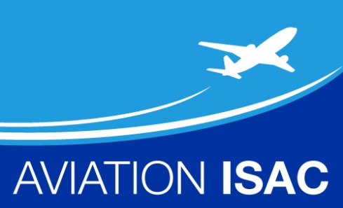
Aviation-Information Sharing &
Analysis Center (A-ISAC)
Community Outreach
Monthly Meeting
Date: September 22, 2015
Time: 10:00am-11:00am (EDT)
1

Slide 2
A-ISAC WebEx/Telecom Information
VIRTUAL MEETING DETAILS
1. JOIN WEBEX
2. Get YOUR audio information from the WebEx pop-up
3. Join the Audio: Follow the prompts and enter Attendee ID if prompted
_________________________________________________
Attendee: https://boeing.webex.com/boeing/j.php?MTID=ma23232800b4e21ffe68f0adfa9e3eb1a
Host: https://boeing.webex.com/boeing/j.php?MTID=ma23232800b4e21ffe68f0adfa9e3eb1a
Meeting links work for Smart Phones and most other mobile devices!
Join Only by Phone (You won't be joining WebEx)
Provide your phone number when you join the meeting to receive a call back. Alternatively, you can call:
Call in: 1-888-854-9758 (US)
Caller-paid call in: 1-214-765-0446 (US)
Show global numbers: https://www.teleconference.att.com/servlet/glbAccess?process=1&accessNumber=888-854-9758&accessCode=3202229&accessNumber2=214-765-0446
Participant passcode: 320 222 9
International Dial-IN Numbers – see meeting notice
--------------------------------------------------------------------
If you are unable to join with the above link, then use the following information:
WebEx site: https://boeing.webex.com
Meeting number: 890 386 378
Meeting password: ProAviation15!
Host Key: 493964

Slide 3
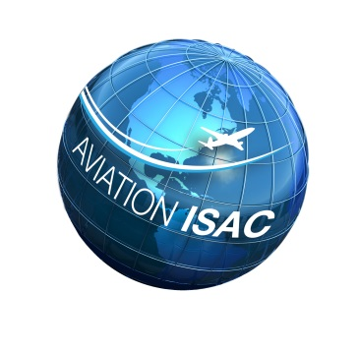
A-ISAC Community Outreach Agenda –
Tuesday September 22, 2015
Time (EDT) | Topic | Facilitator
10:00 | Welcome A-ISAC Community A-ISAC Update | John Craig, A-ISAC Board Chair, Faye Francy, A-ISAC Executive Director
10:10 | A-ISAC Monthly Intel Sharing | Doug Blough, Senior Analyst
10:20 | Information Sharing Across the Transportation Sector - Rail ISAC - AAR / TSSCSWG - Transportation Private Sector leader / PCIS / CSCSWG | Thomas Farmer, Assistant Vice President, Association of American Railroads (AAR) – Transportation Sector Private Sector Leader
10:50 | Around the Room | All
10:55 | Final Comments & Questions | Faye Francy, A-ISAC Executive Director

Slide 4
A-ISAC Monthly Update
Membership Status
  Current Members: 16
  Potential Members / In-Discussions: 4
Engagements
  DHS ETTE Meeting with Andy Ozment (DHS Asst Secretary, Office of Cybersecurity & Communicaitons)
  NCI Quarterly Review – Marketing Campaign / New Portal
  September: Aviation Security Conference: Dubai, UAE (9-16-17)
    Francy providing presentation (Airbus, Boeing, DHS CERT, TSA, FAA, GE Aviation, Rockwell Collins, American Airlines)
  September Board & Analyst Workshop (9-23/24)
    If member would like to attend, they must sign the Subscriber Agreement

Slide 5
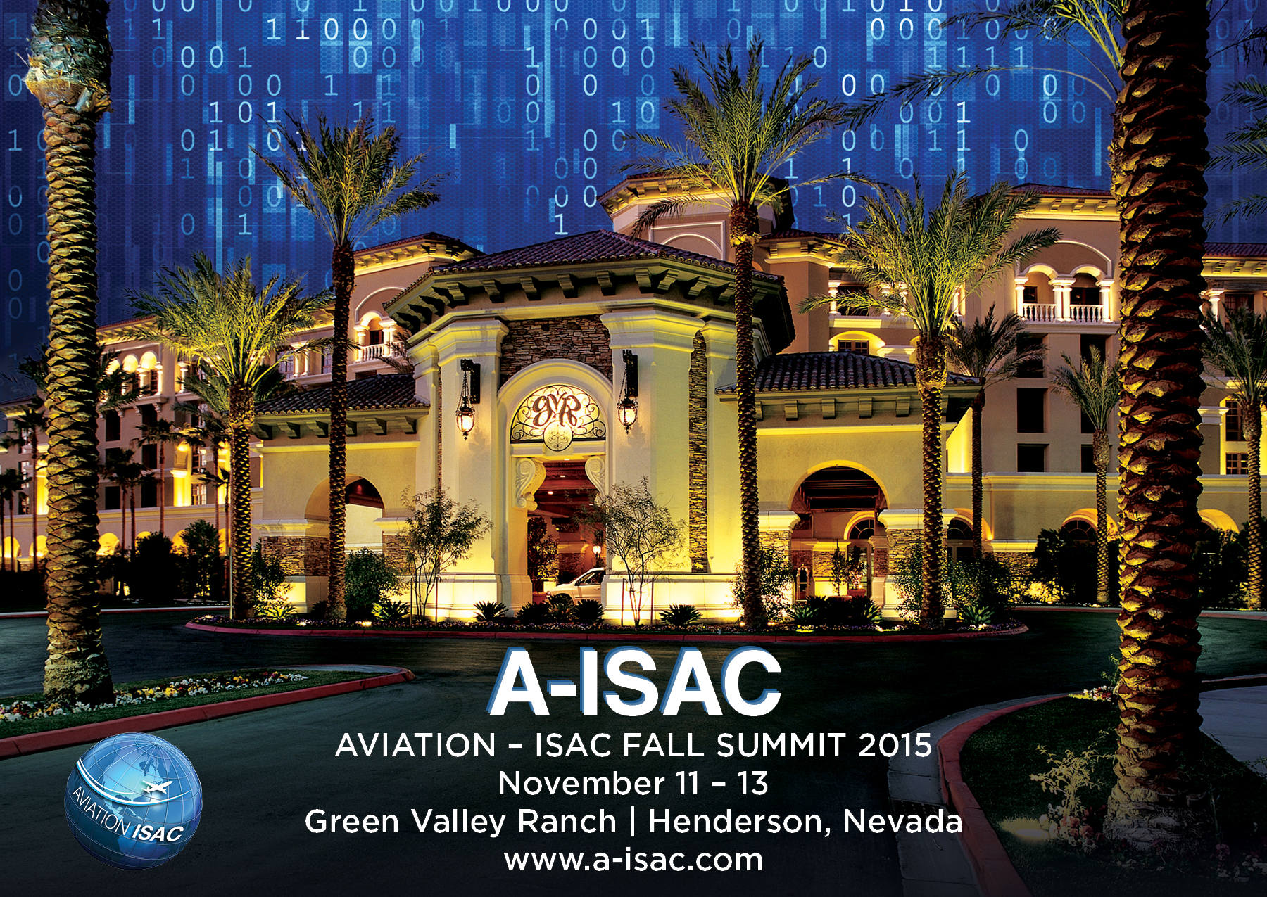

Slide 6
A-ISAC Fall Summit Details
REGISTRATION IS NOW OPEN FOR THE A-ISAC FALL SUMMIT!
Early birds who register before September 24 will pay only $300
Online registration is now open, and be sure to visit the Summit website for regular updates!
SCHEDULE
Date: November 11-13
Location: Green Valley Ranch, Henderson, NV, just outside of Las Vegas
Closest Airport: McCarran International Airport
Wednesday evening: Welcome Reception – please join us at the sponsored reception in preparation of two days of learning and information sharing.
Thursday & Friday: Two full days of plenary and breakout sessions that will inform, educate and challenge you.
Eight breakout session tracks are planned:
  The Importance of Information Sharing
  Governance (**BoD Members Needed)
  Table Exercises & Use Cases
  Threats and Attacks
  Analytics and Intelligence
  Incidence Response
  Best Practices
  Annual General Membership Meeting

Slide 7
2nd Quarter
3rd
Quarter
4th Quarter
A-ISAC Look Ahead
Analyst Workshop
A-ISAC Summit Planning
Member Survey
Auto-Ingest Beta Test
Data Optimization Report
Trends / Analysis Plan
Regional Summits Plan
International Strategy
Hire Part-Time Employees
Analyst Workshop (GE)
Member Survey (E&A)
F2F BoD Mtg (Seattle)
Hire Auditor
Analyst Workshop (Boeing- Long Acres)
Membership Guidelines
Incident Response Plan
Incident Response Proc.
A-ISAC Training Plan
Webinar Capability Roll Out
Operating Rules final
Bi-weekly Threat calls
A-ISAC Community Outreach
DHS CRADA
June- start Membership drive
A-ISAC Public Website
Analyst Portal
Threat Intel Committee

Slide 8

Aviation Sector Threat Sharing
TLP GREEN
11 employees at A‐ISAC partner receive spearphishing emails auto-forwarded from an account at Italian aerospace company
  Hosting CVE‐2015‐5119 Flash exploit exposed in Hacking Team breach
  Emails contained a link to a watering hole site
  No employees clicked the link
  Alenia notified and performed mitigation actions
Joker's Stash Claims Breach of Major International Airport
  Major seller of compromised credit card data-"Big Bada Boom"
  Not commented specifically on size of breach, each batch expected to contain roughly 20,000 records based on actor's previous releases
  We’re hearing that claimed source of card data may be intentional deception in attempt to obfuscate real source of compromise…research ongoing
  Likely the shared kiosk infrastructure at European or Asian airport
Malware found in Cisco-made routers worldwide
  SYNful Knock Campaign webpage that contains embedded OpenType fonts
  Impact of finding this implant on your network is severe and most likely indicates the presence of other footholds or compromised systems
  Snort signature from Cisco to help detect attacks leveraging this malware
  Cisco working with victims directly
Other topics of Interest:
  9/11: ISIS Twitter Bomb Threat – multiple threats against airlines, all non-credible
  ICS Cybersecurity For The C-Suite
  Likely DDoS against Utah airport by known actor, Gator League claiming attacks
TLP GREEN
Aviation ISAC Proprietary. All rights reserved.
Notes:
Open Source Claims against aviation industry
United Airlines
AA
SABRE
Aviation Industry Targeted at various target points
Fake LinkedIn Persona Targeting Aerospace Companies
14 Jul. – A-ISAC partner observes LinkedIn connection requests from a fake persona to 23 employees mostly working on space exploration projects
Persona claimed to be of Persian descent and work at Raytheon; also had Facebook persona
Reply-to email address shaaaaaalize[at]yahoo.com
20 Jul. – Domain raytheon-hr[.]com registered; LinkedIn requests changed to shalize.peyvan[at]raytheon-hr[.]com.
1 recipient received email directly from raytheon-hr[.]com domain containing a web bug; no compromise
At least 480 employees in at least 21 other companies connected with the fake persona; most were aerospace related including 9 OEMs & 2 airlines
Campaign is ongoing
Spearphishing
APT Group Wekby Leveraging Adobe Flash Exploit (CVE-2015-5119)
As if the recent breach and subsequent public data dump involving the Italian company Hacking Team wasn’t bad enough, it all gets just a little bit worse. Emerging from the bowels of Hacking Team data dump was a Flash 0-day exploit (CVE-2015-5119) that was just patched today by Adobe as covered in APSB15-16. The exploit has since been added into the Angler Exploit Kit and integrated into Metasploit. However, not to be out done, APT attackers have also started leveraging the exploit in targeted spear phishing attacks as well. Before we start dishing the details, there is going to be one main takeaway from this blog post: If you haven’t already, update/patch your Adobe Flash now.
A well known APT threat group, often referred to as Wekby, kicked off a rather ironic spear phishing campaign. The attackers launched spoofed e-mail messages purporting to be from Adobe. The e-mail messages references an Adobe Flash update and encourage the recipients to click a link to download and install the update. Take a look at an example of the spear phish e-mail message below.
According to recent information, cyber actors targeted three U.S. aerospace companies with spearphishing emails on 16 July 2015 at 1708Z, 23 July 2015 at 1530Z, and 27 July 2015 1333Z. The actor used email account "news.aero@yahoo.com" to construct and send aerospace news themed emails that redirected users to one of two likely malicious malware laden websites. Spearphishing emails were sent to a total of 44 U.S. victims. It is likely that one U.S. aerospace company was compromised in relation to this activity.
Securing Merchant Card Payment Systems from the Risks of Remote Access
Implementing multi-­‐factor authentication on remote access devices reduces the risk of attackers gaining access to the network. Too often, this added layer of security is not configured in remote access platforms, making it a common target in past data breaches. Appendix C contains examples for enabling and configuring multi-­ factor authentication for the popular and widely deployed Citrix platform XenApp. Most other remote access platforms provide similar support for multi-­‐factor authentication. Organizations should evaluate their current policies and consider the potential elevation of risk as it relates to their individual environments. The below recommendations related to techniques that can prove effective in limiting the success of observed attacks, or otherwise limit the potential for adverse impacts.
Many companies will be upgrading card payment processing hardware and equipment in response to the October 2015 liability shift from the financial institution who issues the card to the merchant. Terminals will need to read chips in the card as well as the magnetic stripe on the back of the card. The providers f these updated card payment hardware may also provide bundle of other security enhancements that reduce the risk that the card payment data can be compromised.
Brute Force Campaign
An A-ISAC member has noticed this morning there were several attempts, every minute to logon as root from ip 218.87.111.109 and from 43.229.53.84
Too many failed logon attempts on an FTP Server

Slide 9
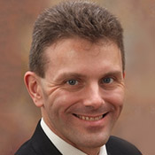
Thomas L. Farmer
Thomas L. Farmer
Assistant Vice President – Security
Association of American Railroads (AAR)
As the Assistant Vice President for Security for the Association of American Railroads (AAR), Tom coordinates development of railroad industry security policy and serves as the principal rail industry liaison with USG on matters pertaining to security.
  Tom serves as coordinator of the Rail Security Working Committee and the Rail Sector Coordinating Council
  Chair of the Partnership for Critical Infrastructure Security (PCIS) Cross-Sector Council, Tom works with the lead representatives for each of the critical infrastructure sectors and with senior government officials in coordinated efforts to advance priorities and capabilities in critical infrastructure protection and resilience.
  Transportation Security Administration (TSA), in both the Mass Transit and Passenger Rail Security Division (2006-2010) and Office of Chief Counsel (2004-2006).

Slide 10
Questions / Comments
Closing Remarks
Faye Francy
A-ISAC Executive Director

