Slide 1
We’ve been p0wn’d?
Review of 2015 Surface Transportation Cybersecurity Incidents
2015 TRB Session 850
Edward Fok
USDOT/FHWA – Resource Center

Slide 2
Just what are we talking about?
This is ONLY about cyber incidents on the Surface Transportation Infrastructure
No aircraft
No rail
No ships
No Hyperloop
It only covers what we know.
No names of vendors or agencies will be used

Slide 3
Our Playing Field

Slide 4
The Other Team

Slide 5
Our 2015 Score Board
Hacking the World’s Traffic Control Systems (Group I)
Open Source Collection/Recon
System Scanning Profiling
Green Lights Forever (Group I)
+System Compromise
SUN_HACKER (Group I)
+System Control

Slide 6
Hacking the Workld’s Traffic Control System

Slide 7
Hacking the World’s Traffic Control System
Sensational claims of accessing traffic control system via wirelessly connected sensors.
Claimed vulnerable products deployed around the world.
Demonstrated ability to:
Intercept data between sensor and roadside receiver
Inject data between sensor and roadside receiver
Attack using both portable & UAV platforms
Overwrite sensor software
‘Brick’ (disable via bad software update) wireless sensor

Slide 8
Hacking the World’s Traffic Control System
Operational Impact: NOT A WHOLE LOT
Why?
The wireless link between the sensor and the roadside receiver is a weak link
The sensor is susceptible to ‘remote’ tampering – but within radio range.
Bad sensor data – normal part of everyday operation
No evidence of inward movement – even with encouragement

Slide 9
Green Lights Forever
Graduate school class project partnered with Public Agency
Published in USENIX Technical Proceeding – this is a penetration test
Exploited vulnerabilities with Center to Field systems
Demonstrated remote control of signal controller
Unable to produce “Bruce Willis” or “The Italian Job” effect – specifically confirm effectiveness of Conflict Monitor
Mass media did not read the paper – the world did not end

Slide 10
Green Lights Forever
Operational Impact:
Center to field wireless network vulnerability (again)***
Controller was open – protection considered a network responsibility.
Conflict Green did not happen, but stop time was demonstrated. Other dangerous condition could’ve been created.
Instructions on controller operations available online. Posted by non-manufacturer sources.
Why
Information can facilitate other attacks

Slide 11
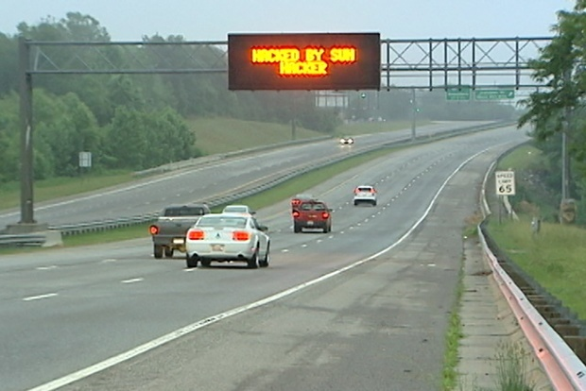
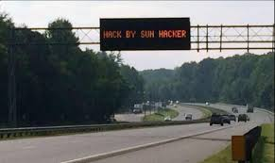
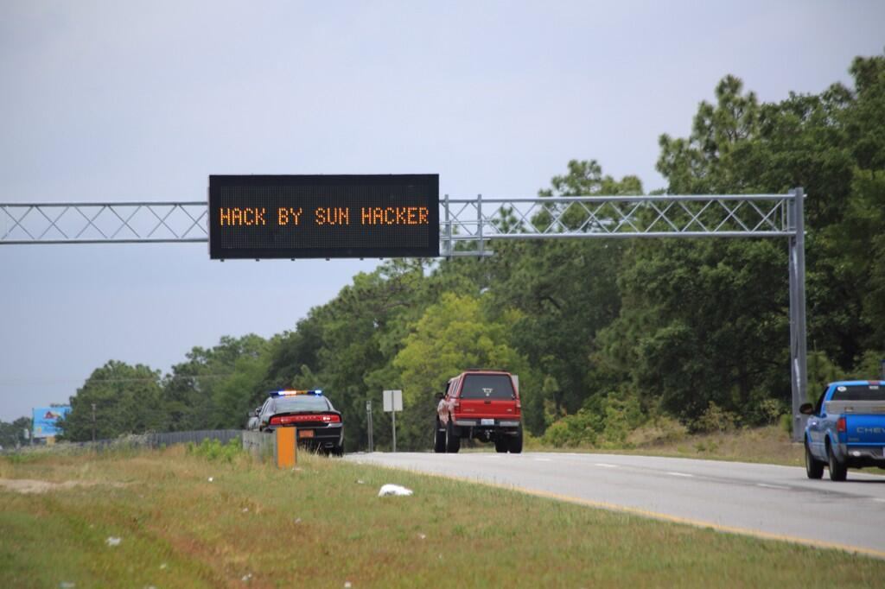

Slide 12
SUN_HACKER
Dynamic Message Sign Hack
Multiple States – at least 4 confirmed. There could be others
Attack took place over a 72 hour period (maximum)
Twitter Handle: SUN_HACKER
Claimed credit on both DMS sign and on Twitter
Twitter account originated from the Middle East
User name is an experienced Group 1 attacker
Automated Attack Tool maybe involved
First publicized foreign hack into domestic transportation system

Slide 13
SUN_HACKER
Operational Impact:
Breached over cellular Center to Field network (again!)
Systems were visible to SHODAN
375 US signs were visible
Poorly configured modem with unpatched vulnerability
Default or no password used
No other protection were in place
Open source information provided additional attack data
Why?
SUN_HACKER breached other systems using the same exploit

Slide 14
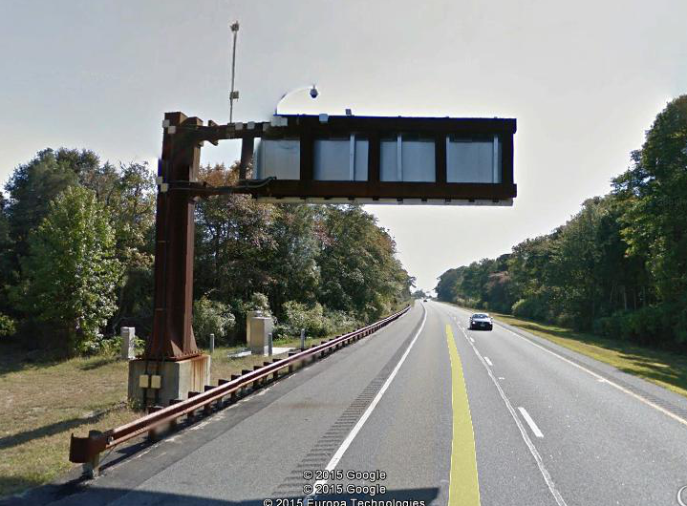

Slide 15
Crowd Source Traffic Information Hack
Developed by Israeli researchers but paper was never published
Utilized software development environment to created virtual traffic devices in the cloud.
Enabling development
Synthetic GPS data generator
Automated script to create virtual users and coordinate synthetic kinematic data.
Current certificate based solutions does not work here

Slide 16
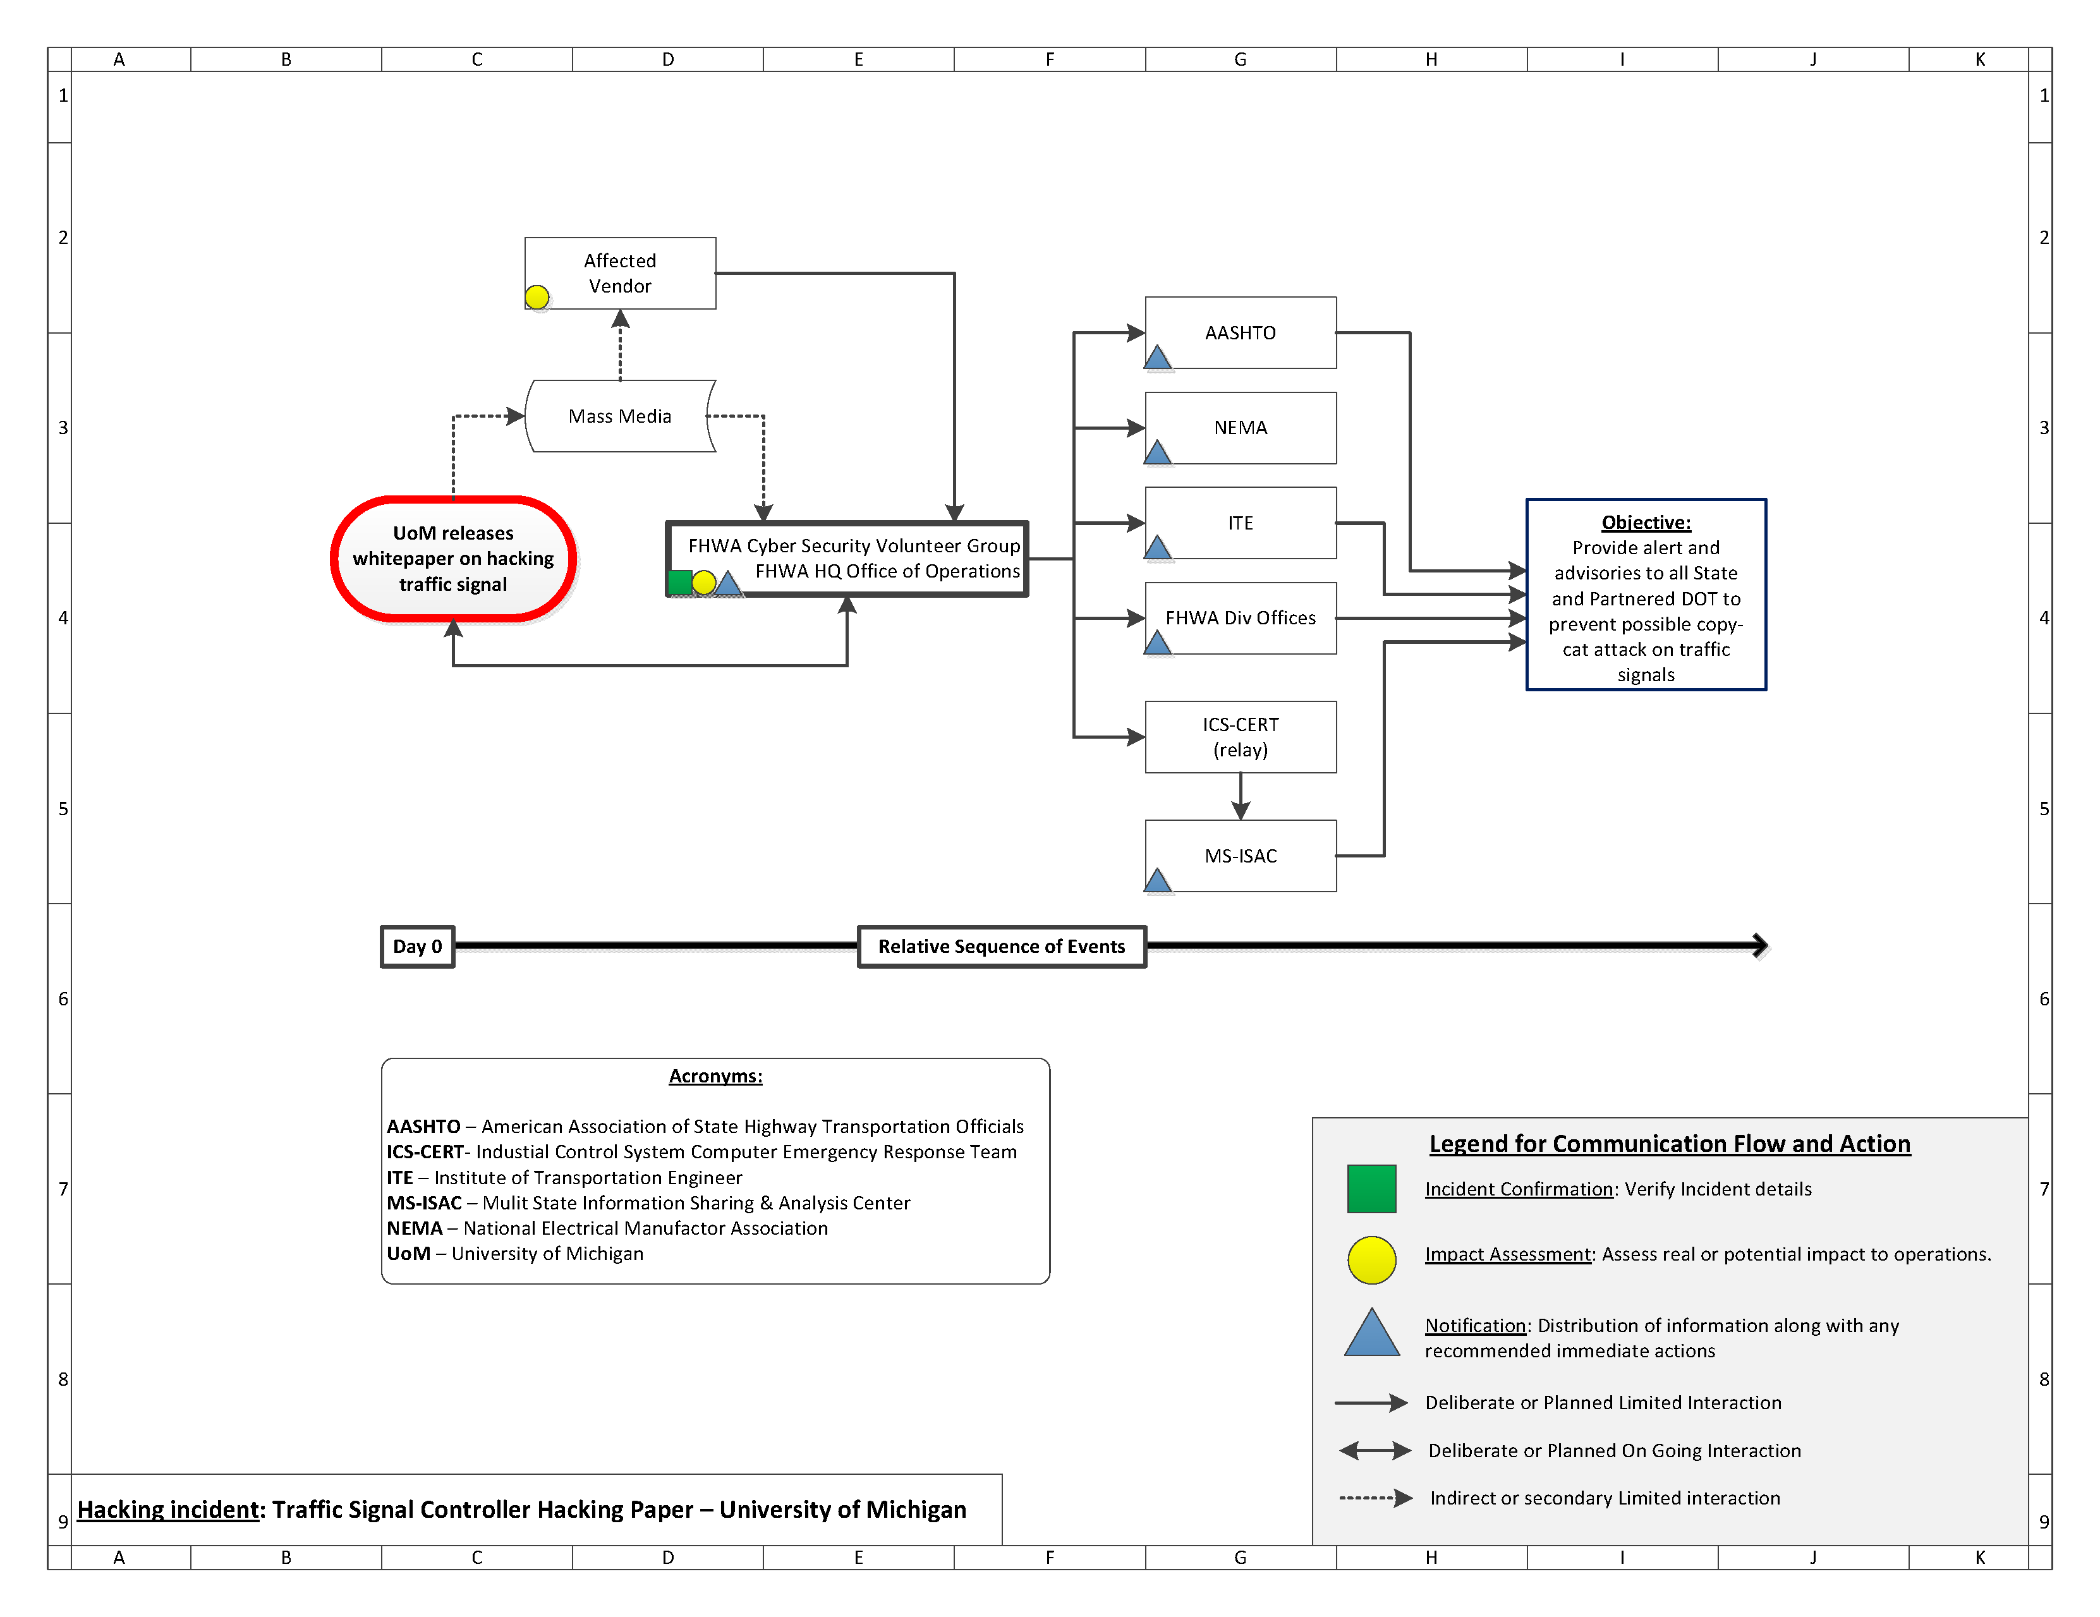

Slide 17
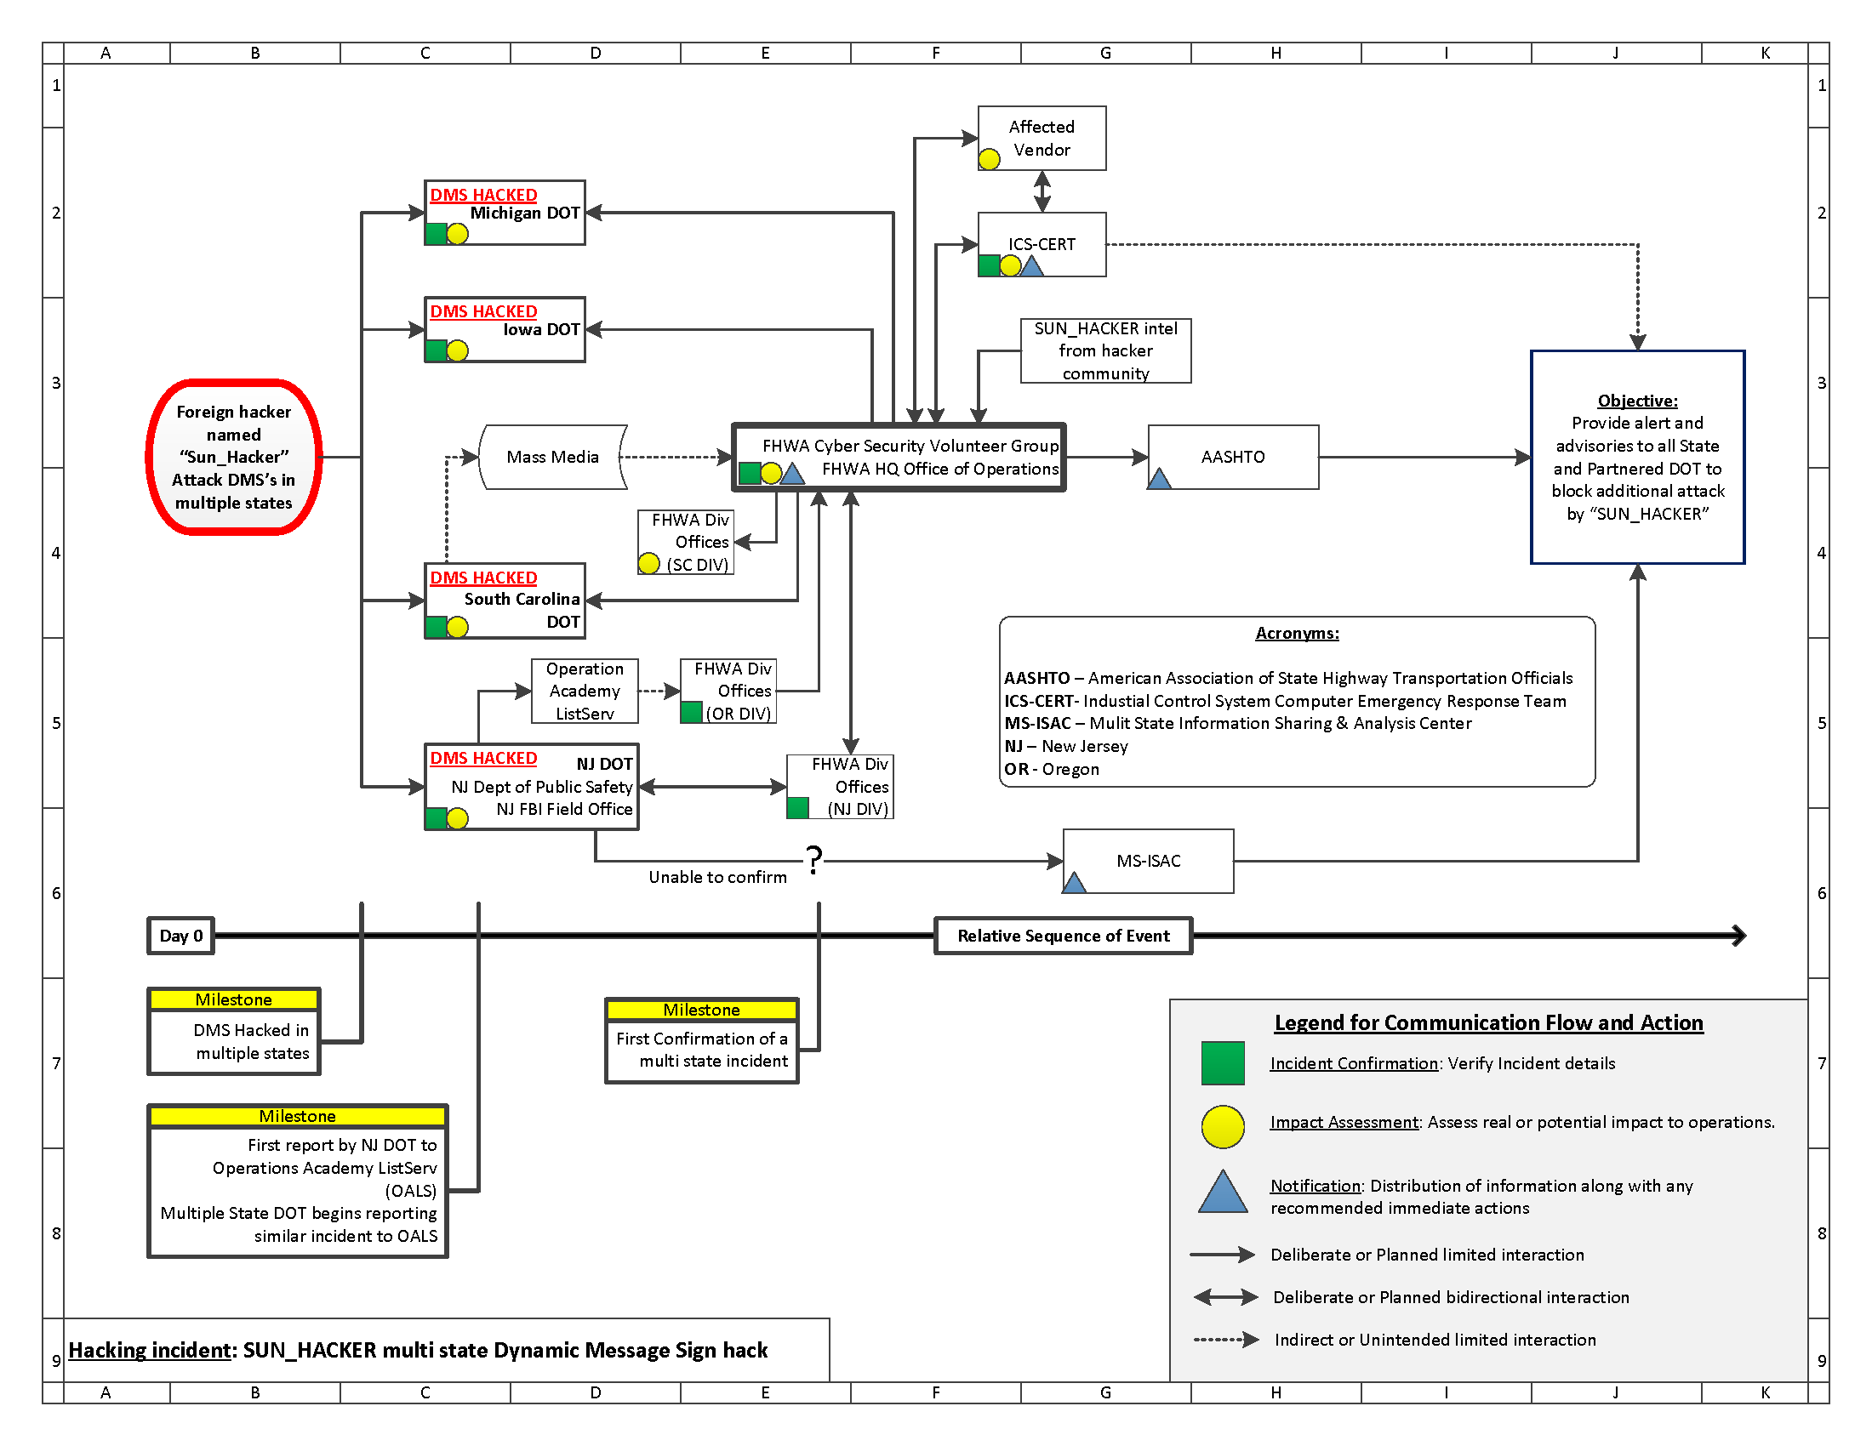

Slide 19
Lesson Learned
We need a better way to communicate and spread the word about incidents.
Cyber Security experts do not have the domain knowledge of transportation system for proper threat assessment
We’re making old mistakes:
Poor configuration practice for wireless network
Poor practice to secure field equipment
Poor practice to patch vulnerabilities

