Slide 1
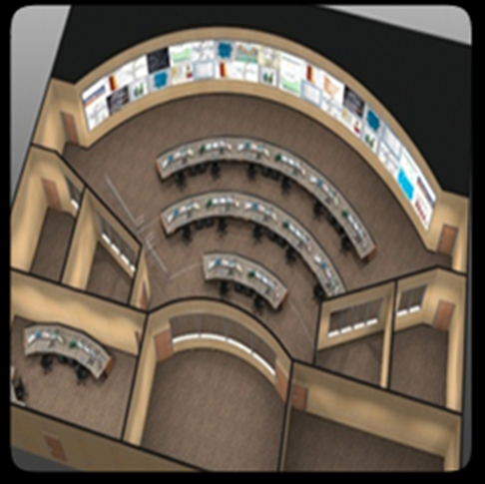

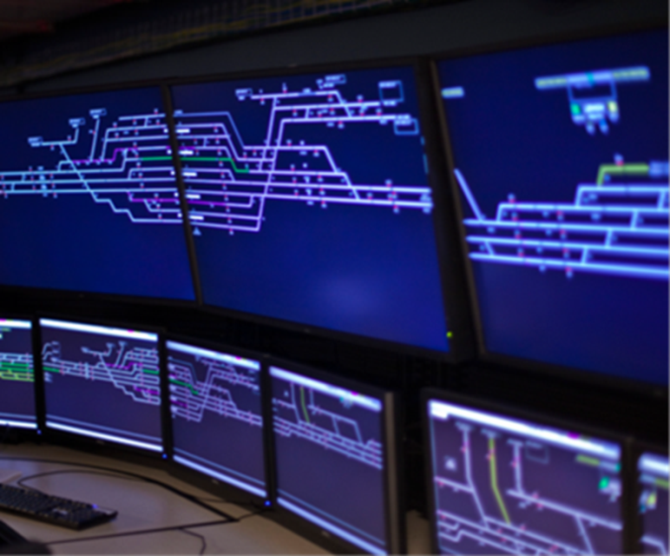


APTA Control and Communications Security Standards, and Cybersecurity Program at MARTA
2015 Transportation Research Board Annual Meeting
Cyber Security Subcommittee, ABE40(7)
January 13, 2015 Washington, D.C.
Joy Thompson, VP Transit Services
enGenius Consulting Group

Slide 2
MARTA Vision and Strategic Priorities
MARTA Vision
Provide a safe, reliable and customer-friendly service
Strategic Priorities
Apply continuous improvement to service delivery
Favorably position MARTA by improving transit’s image and stakeholder relations
Ensure transparency and public accountability
Achieve financial viability and stability
Provide a total quality customer experience
Provide safe and secure services and environments
Enhance employee development and relations
Embrace sustainability through the implementation of environmentally responsible practices

Slide 3

Current Standards Goals
Build a Culture of Cybersecurity
Cybersecurity and ICS are viewed as inseparable and integrated
Assess and Monitor Risk
Utilize the robust portfolio of ICS-recommended security analysis tools to effectively assess and monitor ICS cybersecurity risk.
Develop and Implement Risk Reduction and Mitigation Measures
Security solutions for legacy systems, new architectural designs, and secured communication systems
Manage Incidents
The Authority is quickly alerted of cybersecurity ICS incidents, and sophisticated, effective, and efficient mitigation strategies are implemented and in operation.

Slide 4
Control and Communications Security WG (CCSWG)
APTA CYBER SECURITY STANDARDS
CCSWG Standards Program Includes:
  Recommended Practice Part 1
  Recommended Practice Part 2
  White Paper Part 3a (issue early 2015)
  Recommended Practice Part 3b (end 2015)
Why you should use CCSWG Standard Series:
  Follows DHS/TSA guidance
  Industry consensus
  Leading edge cybers ecurity practices

Slide 5

Safety Critical Systems
Safety Critical Systems List
RFP 13994 - Comprehensive Assessment of
Metropolitan Atlanta Rapid Transit Authority Safety Critical Systems
7 Subject Categories → 24 Review Areas:
Railcar Systems (3 areas)
Bus/Paratransit Systems (6 areas)
Environmental Issues (3 areas)
Track, Power & Signals (3 areas)
System Safety Program Plan (SSPP) /Incident Reporting/Safety Data Management [1 area]
Communications (4 areas)
    Emergency Patron Communication
    800 MHz Radio
    SCADA
    Train Control & Encroachment Detection
Fire & Emergency Equipment (4 areas)
    Fire Detection, Protection & Suppression
    Tunnel Ventilation
    Standby & Emergency Power Systems
    Emergency Lighting
June 1, 2010

Slide 6
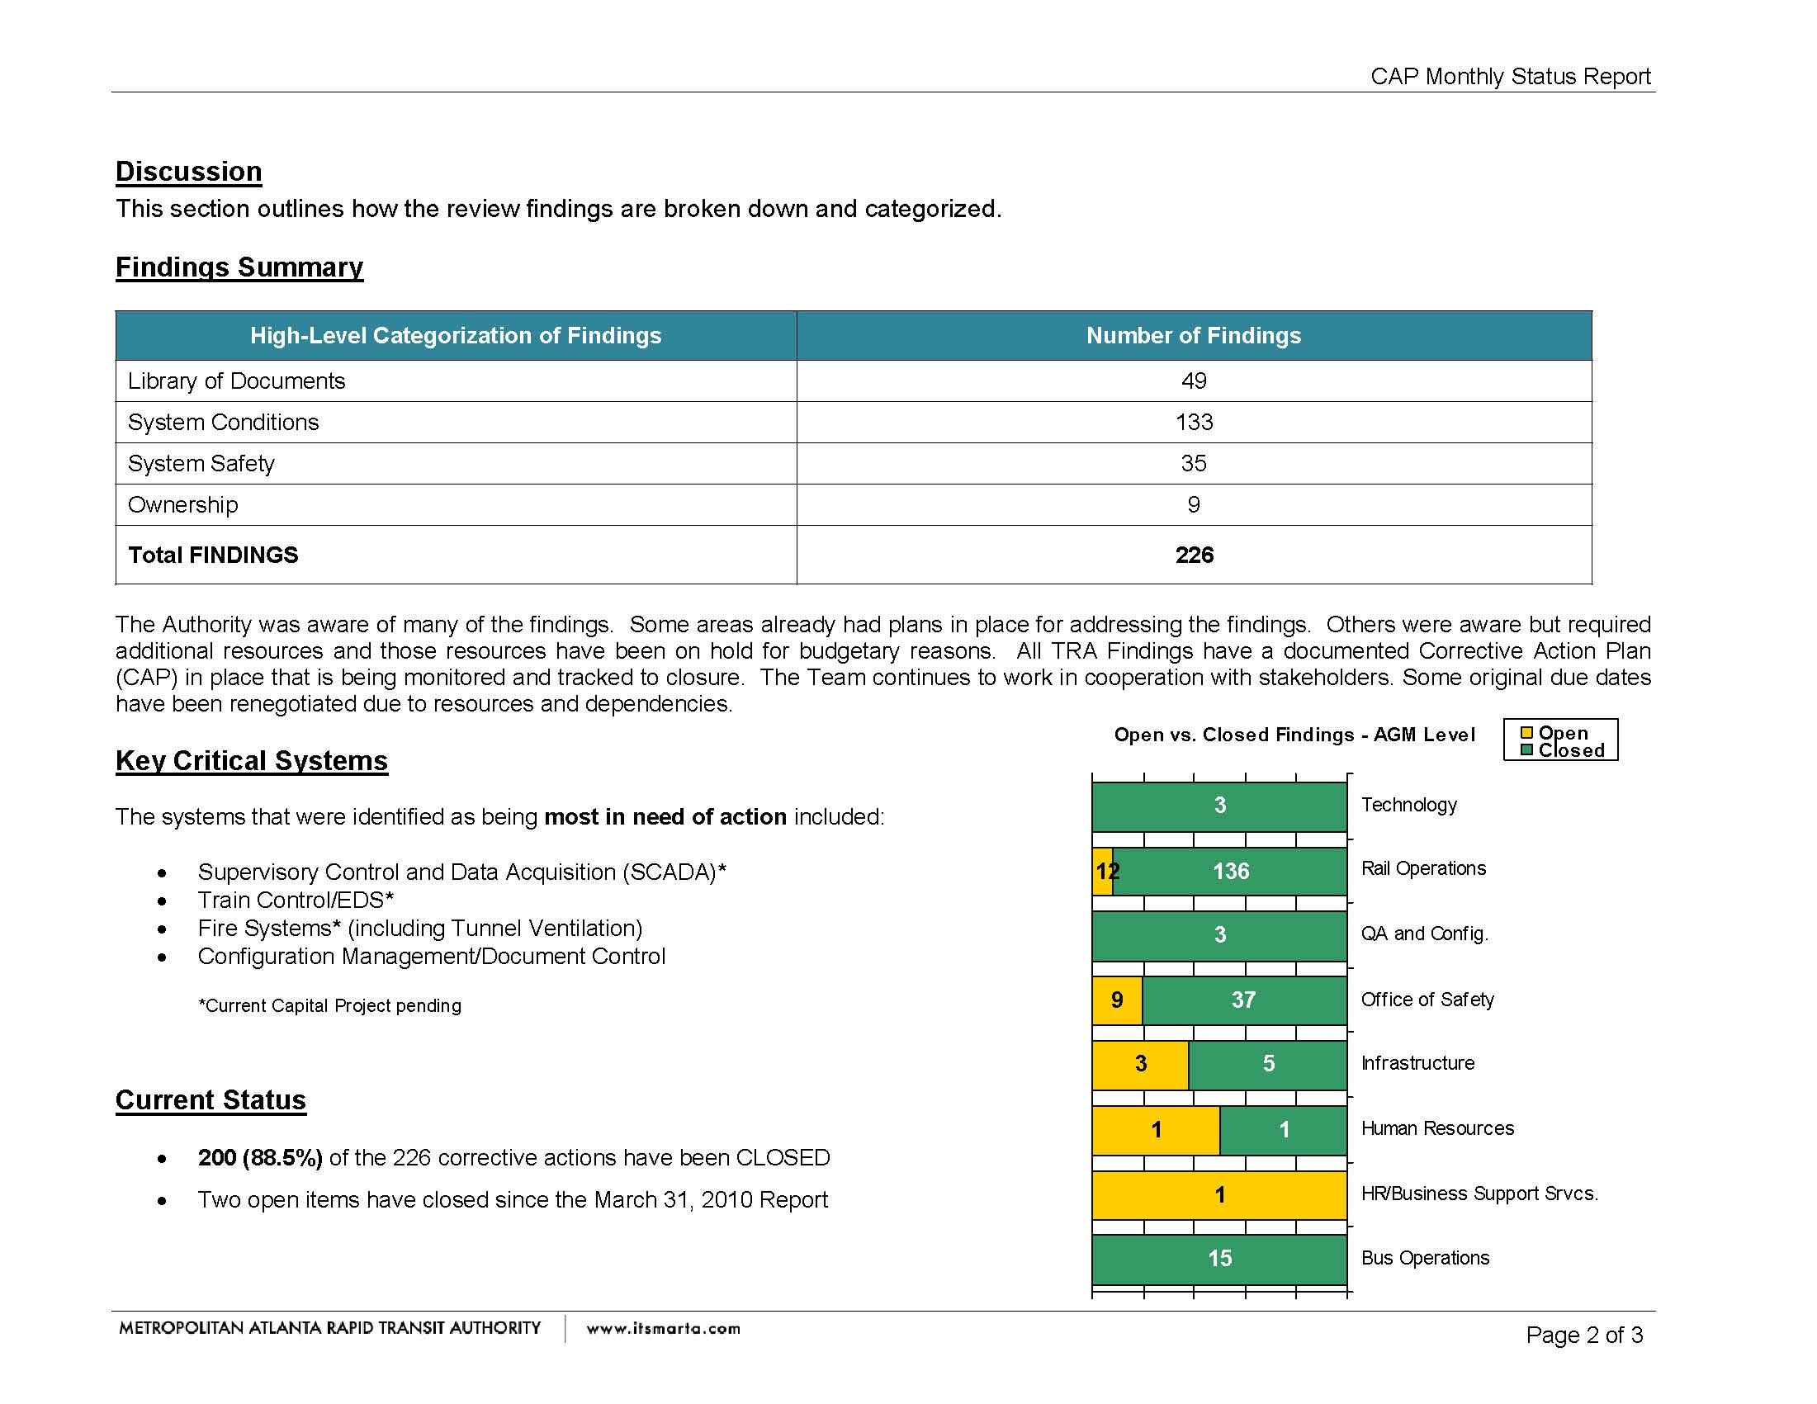
Safety Critical Systems List
RFP13994 - Comprehensive Assessment of
Metropolitan Atlanta Rapid Transit Authority Safety Critical Systems
MARTA’s approach is very similar to APTA’s approach relative to zones.

Slide 7
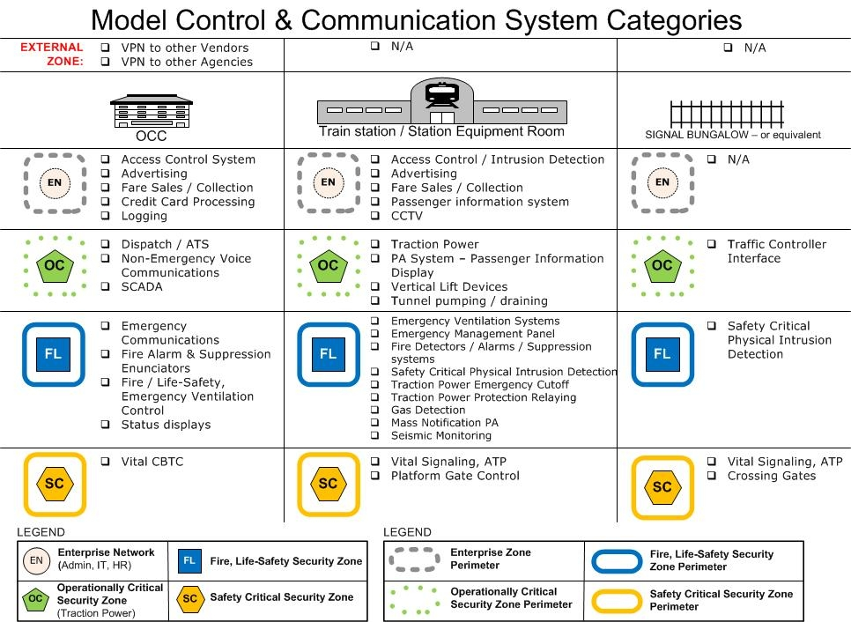
MARTA’s actions to date on this topic map very well to APTA’s Part 2- Security Zones

Slide 8

MARTA Police FY 13 Technology Security Assessment
CSET 4.1 Onsite Consultation and Self Evaluation
IT & Enterprise Network Evaluation
NIST SP800-53
Security Controls for Federal IS & Organizations
MARTA BTP
Industrial Control Systems (ICS)
NIST SP800-82 Guide to Industrial Control Systems Security
Train Control & SCADA
(Alstom & ARINC)
Administrative Standard or Question Set
Security Policy & Procedures
Security Program Mgent
Config. Management
Audit and Accountability
System Development & Maintenance
Physical & Environment Security
Access Control
System & Information Integrity
Network Architecture
System & Communication Protection
December 11, 2012
December 12, 2012
Highlight vulnerabilities
Provide recommendations
Identify areas of strength
Provide a method to compare and monitor cyber systems
Inform risk management and decision-making process; and
Raise awareness and facilitate discussion on cyber security
Benefits
Cyber Security Evaluation Tool

Slide 9

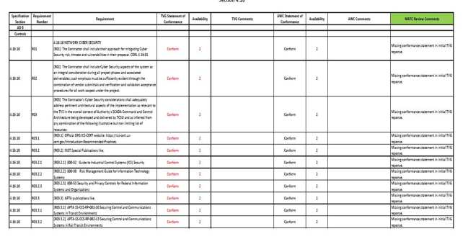
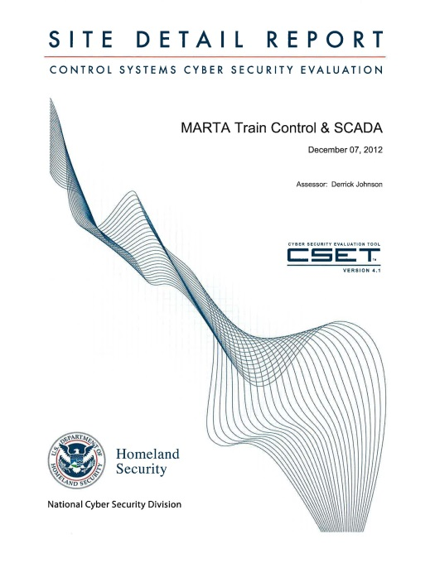
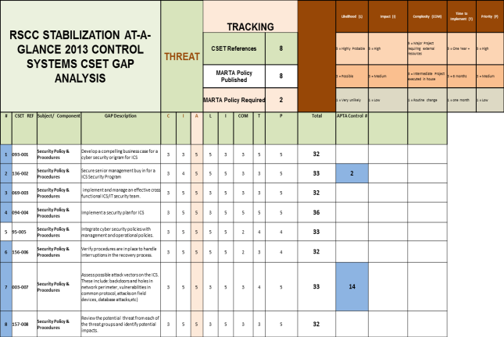
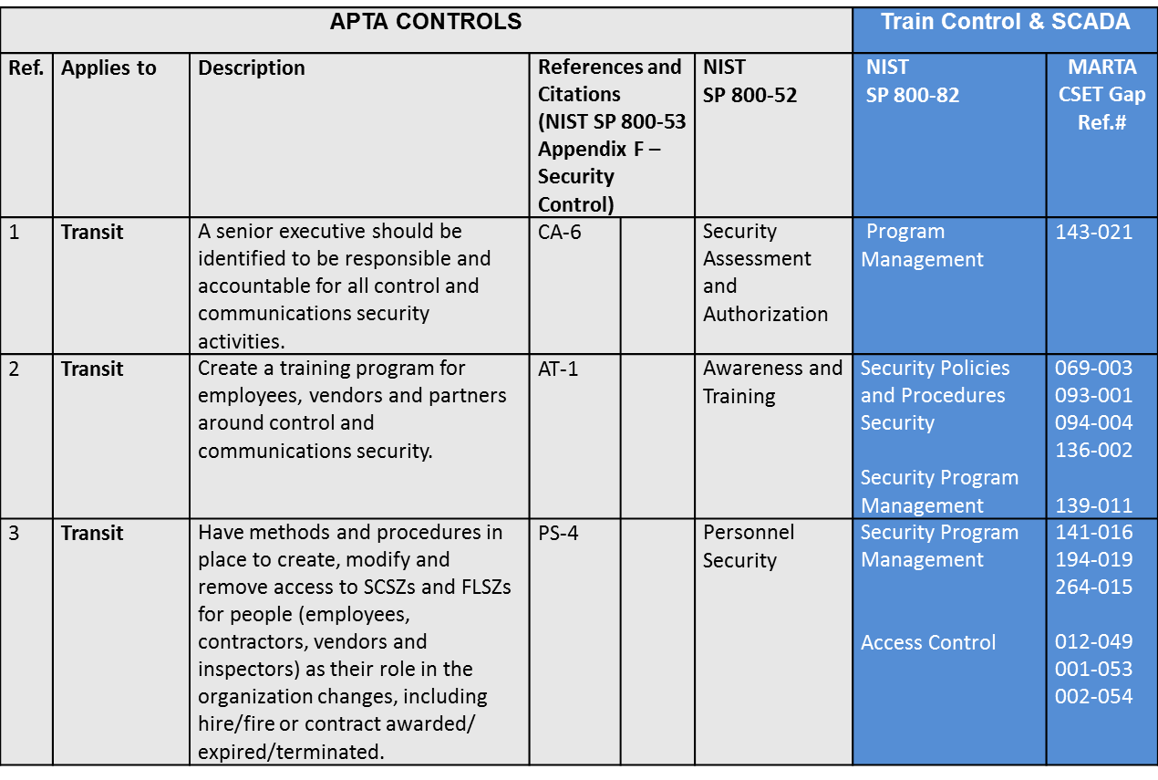
Train Control & SCADA Key Milestones
Cyber Security Requirements
Capital Projects
CSET Onsite
Assessment
Gap Analysis
October 2013
January to March 2013
Nov ember – December 2012
CSET 4.1 APTA Control Mapping Results

Slide 10
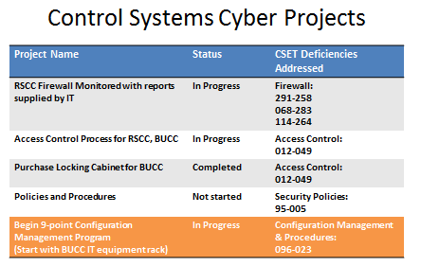
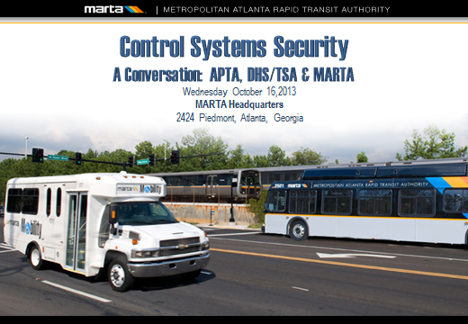
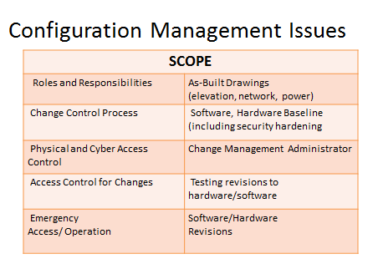
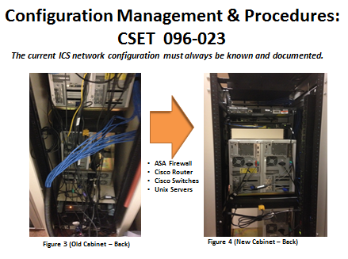
Train Control & SCADA Key Milestones
Cross Functional Work Session
Capital Project Funded
Low Hanging Fruit
APTA, DHS, LA Metro, MARTA
October 2013
July 2014
Cross Functional Team
Ongoing
July - December 2014

Slide 11
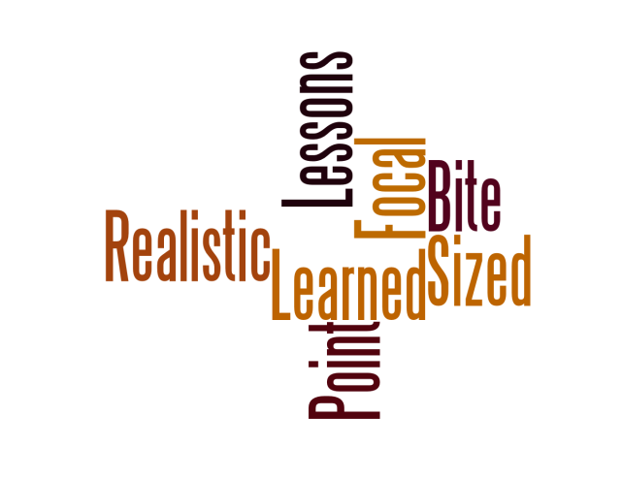
Lessons Learned
Initial MARTA Approach
  Form a Control and Communications Security Team
  Inventory Assets
  Goals and objectives
  Risk Assessment/mitigation (CSET Evaluation)
Choose your focal point
  Legacy/existing Systems (CSET Evaluation)
  Systems under modification/rehabilitation (CSET Evaluation/APTA Standard)
  New up and coming projects (APTA Standard)
Bite sized pieces, be realistic!

Slide 12
Questions?
APTA CYBER SECURITY STANDARDS
Control and Communications Security WG (CCSWG)
Joy Thompson, VP Transit Services - enGenius Consulting Group, CCSWG Chair jthompson@engeniusconsultinginc.com
Dave Teumim, President , Teumim Technical, LLC -Dave431@enter.net - CCSWG Facilitator

