Slide 1
Cyber Security Subcommittee - ABE40(7)
Summary
Michael Dinning
TRB 94th Annual Meeting – January, 2015
The National Transportation Systems Center
U.S. Department of Transportation
Office of the Secretary of Transportation
John A. Volpe National Transportation Systems Center
Advancing transportation innovation for the public good

Slide 2
Cyber Security Subcommittee Focal point for information & research
Roles
Focal point, advocate & resource within TRB
Clearinghouse for information on threats, incidents, mitigation, research
Facilitate networking, coordination & collaboration
Identify needs & guide research
“This is one of the best sources of information on what’s going on in cyber security”

Slide 3
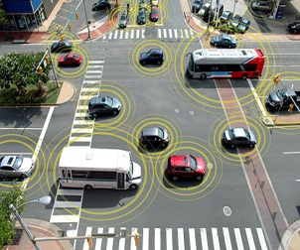
Highlights in 2014
Well-attended annual meeting session and subcommittee meeting
Six telcons, with more than 100 participating
Participation by at least six other committees (ITS, Info. Systems, Eng. Tech., Aviation Sec., Public Trans., Traffic Mgt. etc.)
Expert interpretations of “incidents”
Updates on cyber security research
Coordination with TRB projects
NCHRP
ACRP
Discussion of national
initiatives

Slide 4
Michael Dinning
U.S. Department of Transportation
John A. Volpe National Transportation Systems Center
55 Broadway, Cambridge, MA 02142
michael.dinning@dot.gov
617-494-2422 (o)
617-694-7518 (m)
TRB Cyber Security Resource Center website:
http://trbcybersecurity.erau.edu/
Session 850: Transportation Cybersecurity: Are We Hanging by a Thread?
Wednesday, January 14, 4:30 – 6:00 pm, Convention Center 151B
Notes:
…and I look forward to working with all of you to make it happen!

