Slide 1
2014 Threats in Review
Edward Fok
USDOT – FHWA Resource Center
2014 TRB

Slide 2
Vehicle Hacking
Hacking software released
Ford, Toyota, Mini Cooper
http://blog.ioactive.com/2013/08/car-hacking-content.html
Hacking driverless vehicles
https://www.defcon.org/images/defcon-21/dc-21-presentations/Zoz/DEFCON-21-Zoz-Hacking-Driverless-Vehicles.pdf
http://youtu.be/k5E28fp4oc0

Slide 3
Talking to the masses
Limit Fear, Uncertainty, and Doubt
Concerns about DSRC privacy
Compounded by a blindsided agency
http://youtu.be/T43Ti7c11lY 39:00
http://youtu.be/9uHaeq60p2A 33:14
SQL Hack - Public Transport Victoria, AU – December 27, 2013

Slide 4
St. Johns Ambulance Service
December 11, 2011
Walked in Conflicker virus
Automated response system disabled
AVL of ambulances
Lost of mobile data terminal communication
Crashed on Wednesday night, restored on Saturday morning
Source: Waikato Times, December 11, 2011

Slide 5
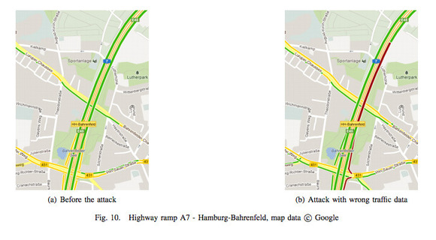
Hacking Floating Car Data
March 12, 2013 Blackhat EU - Messing with Google and Waze traffic information (bh-eu-13-floating-car-data-jeske-wp.pdf)

Slide 6
Payment Card
Christchurch transport card
Kiwicon7 – November, 2013
http://youtu.be/gB3EcBp34Xc
MARTA Breeze Card – December 27, 2013
https://www.myfoxatlanta.com
MiFare Ultralight cards continues to be a problem
Notes:
Christchurch – manage to get 167,769 dollars on his transit card.

Slide 7
PIN numbers
5 (9.21%) |  | 6 (17.78%) |  | 7 (7.28%)
PSWD |  | PSWD |  | PSWD
12345 | 22.80% | 123456 | 11.68% | 1234567 | 3.44%
11111 | 4.48% | 123123 | 1.37% | 7777777 | 1.72%
55555 | 1.77% | 111111 | 1.30% | 1111111 | 0.64%
8 (11.26%) |  | 9 (2.95%) |  | 10 (1.52%)
PSWD |  | PSWD |  | PSWD
12345678 | 11.83% | 123456789 | 35.26% | 1234567890 | 20.43%
11111111 | 1.33% | 987654321 | 3.66% | 0123456789 | 2.32%
88888888 | 0.96% | 123123123 | 1.59% | 0987654321 | 2.27%
http://www.datagenetics.com/blog/september32012/
Notes:
Transit property owners should see the first video. The hacker community have known about vulnerabilities in certain class of transit vehicle for two years now. The problem that needs to be solved here is how to engage that community.
And then we have passwords… These are statistics based on password data bases that have already been released and exposed via previous security breaches.
Sample Size: 4 = 3.4 million ~ 49.16% of all sample
Least popular = 8068, until now.
4th most popular 7 digit password Song by Tommy Tutone in 1982
The strength of the password is just one part of the issue. Another part is how well protected is the password on the machine. Most of the breach involved unencrypted password files. Technology is getting to the point traditional encryption will no longer work.
We are more exposed the we can imagine and frequently we are making the same mistakes over and over again.

Slide 8
Source: Trustwave 2013 Global Security Report

Slide 9
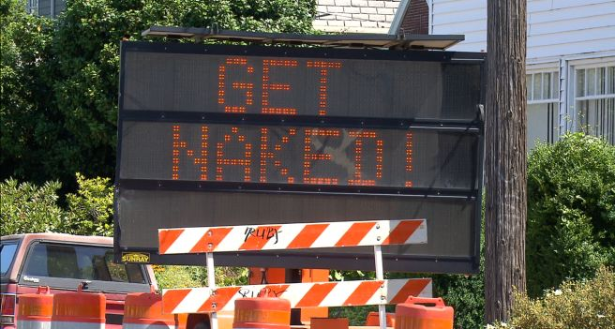
Old problems … reimagined…

